Slide 1
Meeting Week 1
This lets you steer the meeting to what you require out of the meeting to make progress.
Last week summary
Action point 1
…
Question 1
…
Outline ToDo next week

Slide 2
Last week summary
Theory or research discussed last week summarized. What was discussed last week. Professor and PhD only work on this project 1-2hrs per week not 40hrs like you.
Some figure explaining the concept
When applicable, the same as will go in final report. Otherwise just take screenshots from relevant papers.

Slide 3
Invertibility
Discuss model. Clearly explain what is q, how is the model constructed. Maybe an image of the dual-gantry? But then I need to understand it quite well
  Remember coulomb not modeled
  State for example the coordinates of Y (same for X1 X2 or theta) How is it derived? Mainly should be talking about what the current model represents.
  Explain Logical coordinates and …, then its also clear why we call them these.
LPV-LFR construction
Ask about which coordinates to use? Matlab use the logical so I used that → impact on input output? Or should I transform?

Slide 4
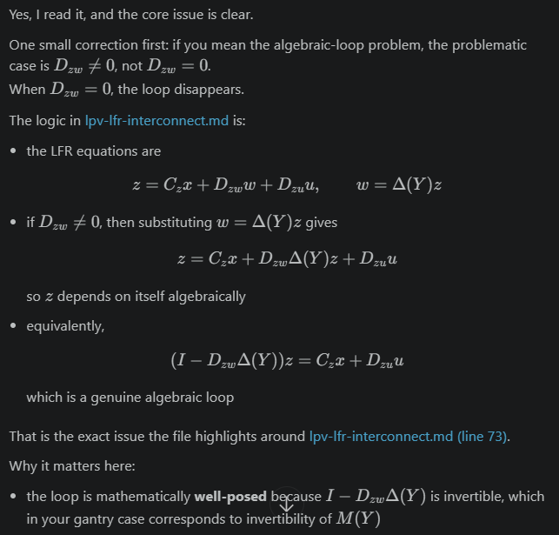
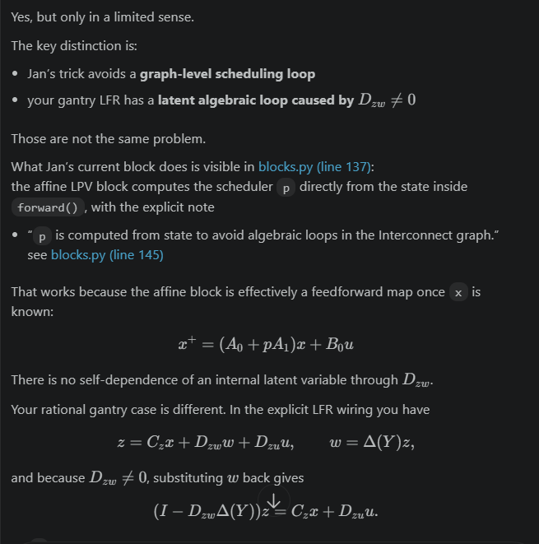
Algebraic loop problem
It is well-posed by invertible, but algebraic loop
Jan’s code is not structured around this, maybe rederive or use Roel’s code?

Slide 5
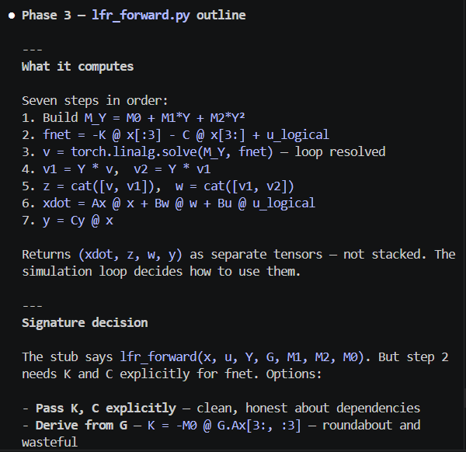
Current work around algebraic loop
Jan’s code doesn’t allow for algebraic loops
The algebraic loop that currently exists for our rational case (Dzw is not zero)
How we work around that.

Slide 6
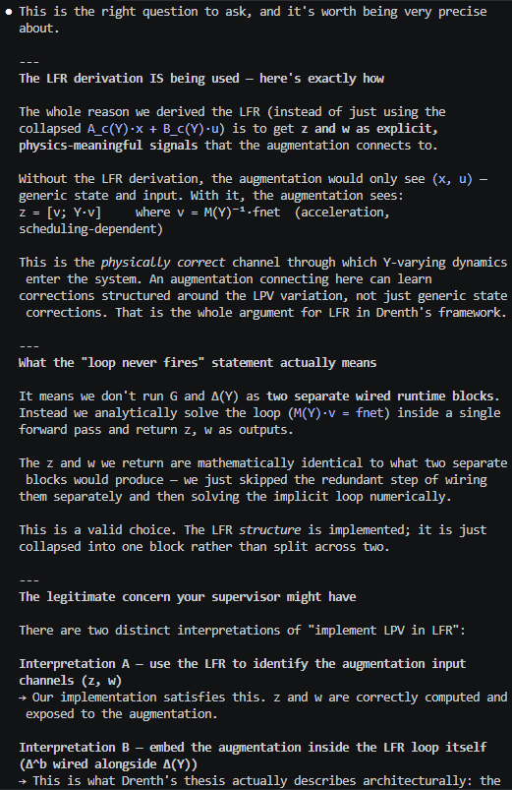
Algebraic loop problem. Dont run tow seperate G and deltaY block as two seperate wired runtime blocks instead we analytically solve the loop (M(Y)*v = fnet) inside a single forward pass and return z, w as outputs.

Slide 7
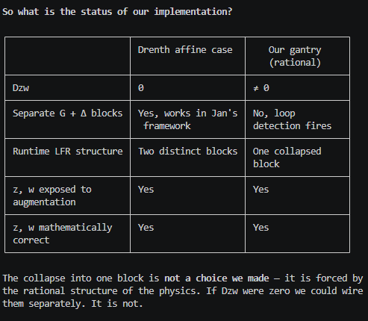
So what is the status of our implementation?
The collapse into one block is not a choice we made — it is forced by
the rational structure of the physics. If Dzw were zero we could wire
them separately. It is not.

Slide 8
"The gantry LFR has Dzw ≠ 0 (rational, not affine). Jan's
Interconnect requires acyclic signal graphs. We resolve the algebraic
loop analytically inside the block and expose z and w as outputs for
augmentation. Does this satisfy your intent for 'LPV in LFR', or did
you assume the baseline would be affine?"

Slide 9
Problem with Jan’s Framework
Only works for affine (Dzw=0) case
The rational problem, algebraic loop:
How important is precise LFR structure?
Solutions:
  Use current approach where we collapse but we don’t have the separate delta block
  Rewrite to affine with extra state
  DAE solver?
  Code Roel Drenth?? Different routing mechanism then Jan?

Slide 10
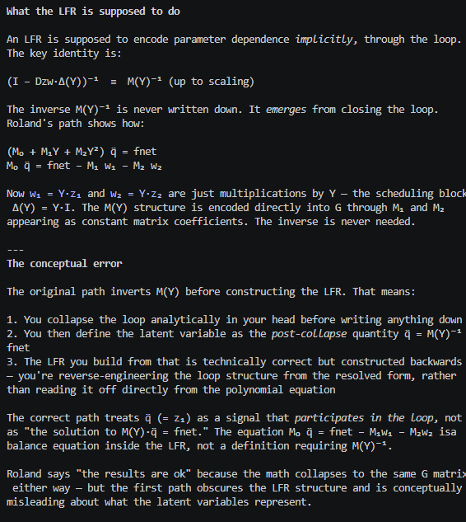
Notes from Roland
Use SVD to reduce
What is the benefit of reducing the dimensions.

Slide 11
Action point 1
You should have a Gantt-chart or some other planning with what should be the next steps in the research.
Questions can also be put here
Some figure showing the result achieved like a plot or some theory.
When applicable, the same as will go in final report. Otherwise just take screenshots from relevant papers.

Slide 12
Question 1
If a question needs to be answered. Make clear here what the problem/question is that needs to be answered. Questions can always be asked outside the meeting, but we may say prepare to explain what you really mean.
Some figure explaining the concept
When applicable, the same as will go in final report. Otherwise just take screenshots from relevant papers.

Slide 13
Outline next week
What is next on the planning and how is that going to be solved
This is also where new action points are formulated. What are you going to do next week.

Slide 14
Possible Gantt-chart or Planning
To keep an overview of what the progress overall is.

